Slide 1
20 DDoS Attacks in 20 Minutes
A quick guide to causing massive disruption

Slide 2

Me
@nobletrout

Slide 3
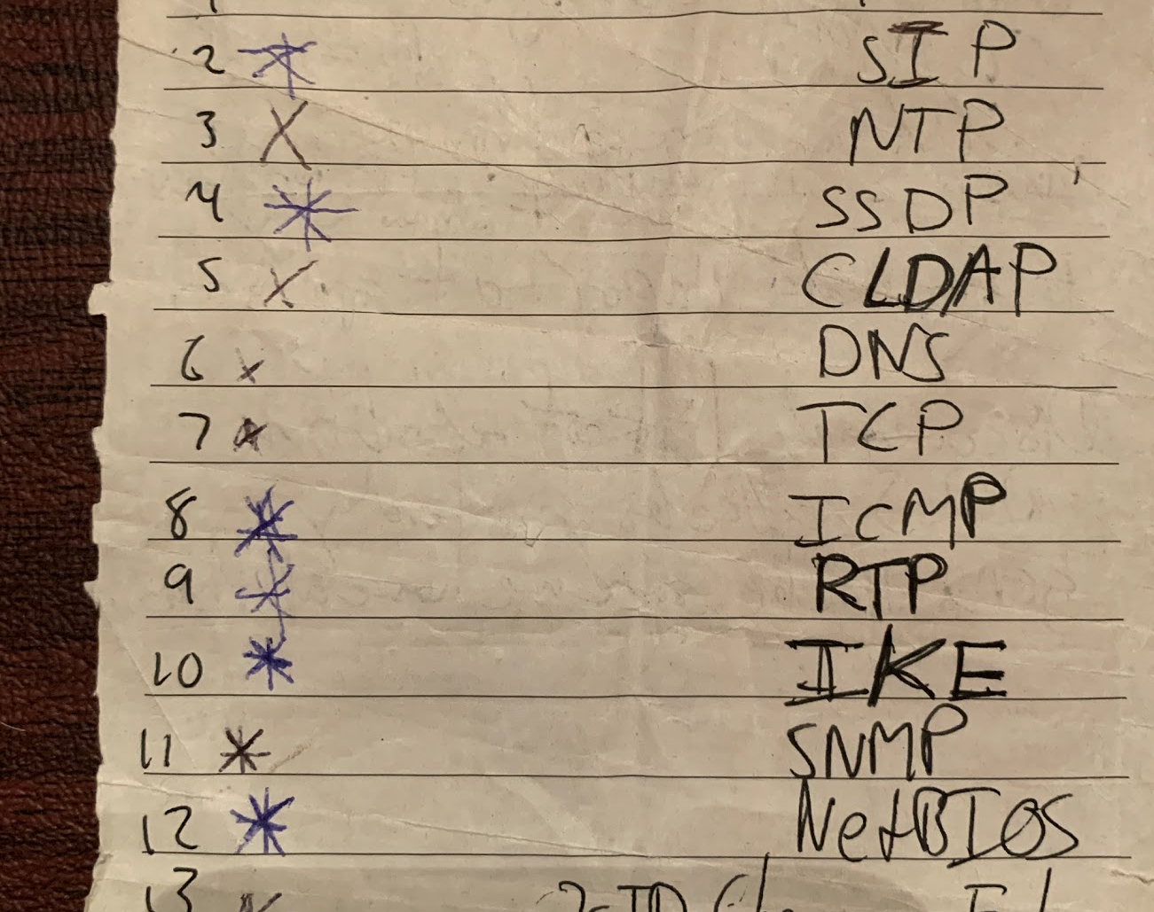
Inspiration

Slide 4
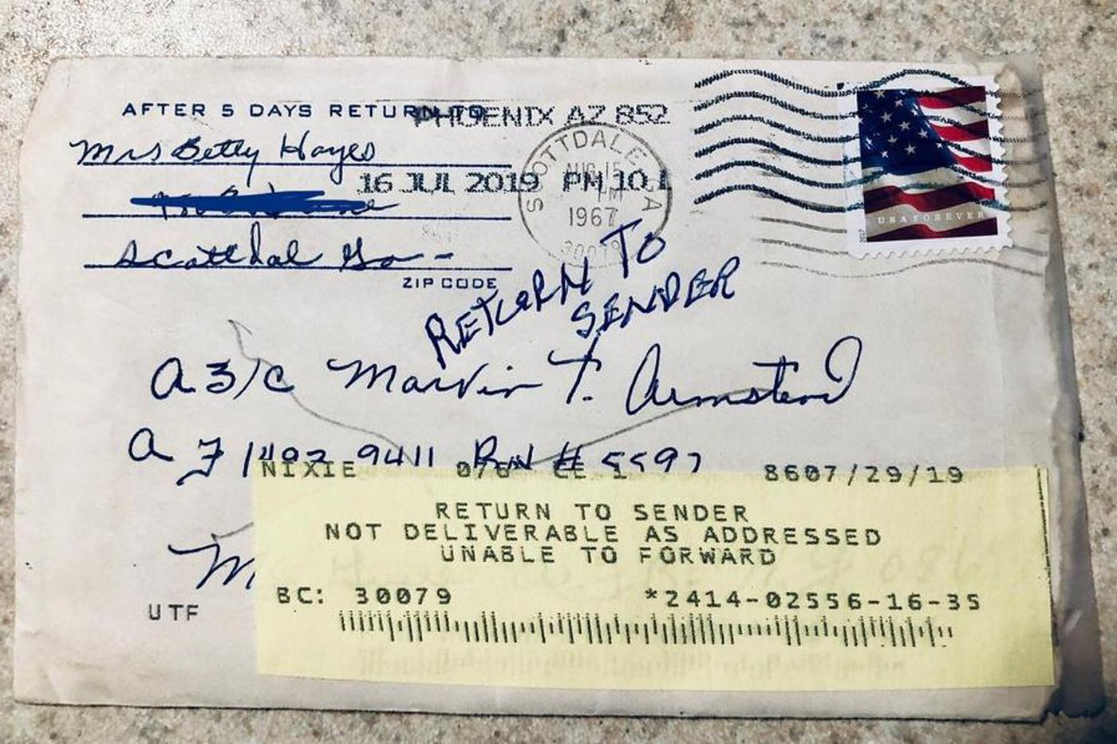
Reflection Attacks

Slide 5
In Microsoft Shapes!
Hacker Man
Sends 100 bytes
Sends request with forged identity
3rd party
Victim
Responds to incorrect address
Response is 500 bytes– amplification factor is 5x

Slide 6

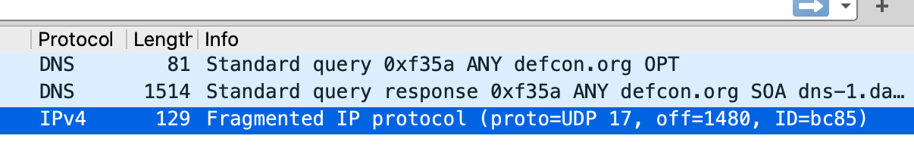
DDoS Attack 1 - DNS
Send a TXT or DNSSec request
Response can be very large
Use dig
dig defcon.org any +bufsize=2000
YMMV
Amplification Level for defcon
Bytes: 20x
Packets: 2x

Slide 7
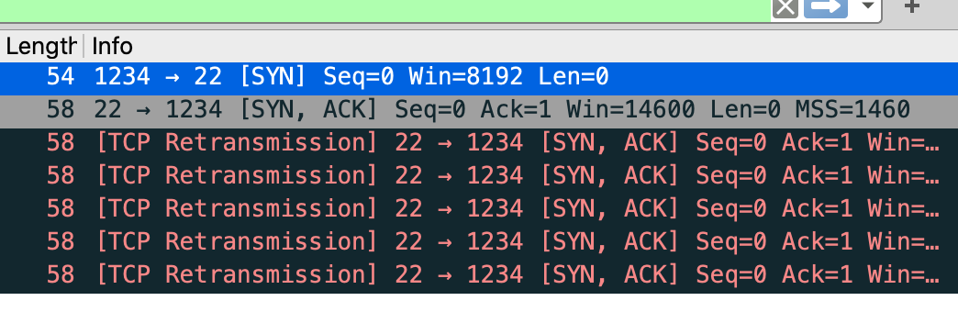
DDoS Attack 2 - TCP
Leverage TCP’s desire to communicate
The stack will by default repeatedly send packets to connection attempts
Flood reflector with SYN’s, for each SYN, it will respond with multiple SYN/ACK’s
Pre-Reqs: a victim that doesn’t respond with RST or a reflector that doesn’t see them.
Amplication Factor
Bytes: 7.5x
Packets: 6x

Slide 8


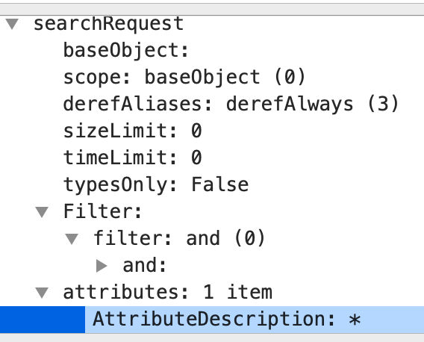
DDOS Attack 3 - CLDAP
Connectionless LDAP
UDP Version of LDAP
Supported by activerecord and OpenLDAP
Allow for a discrete set of queries that are considered “safe”
But you can just query for “*” and set attributes over UDP
Amplification factor
Bytes: 46x
Packets: 2x

Slide 9
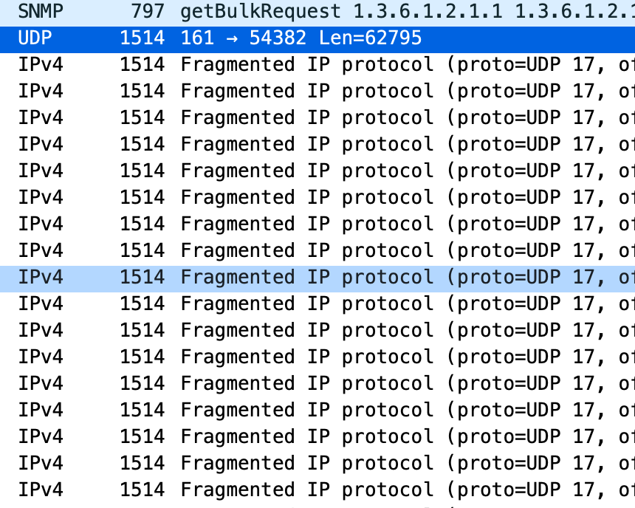
DDOS Attack 4 – SNMP GetNextBulk
You can issue a GetNextBulk request, which asks for the next item in a list, and then the subsequent X number following it.
snmpbulkget -c public -Cn0 -Cr50 198.18.0.1 `perl -e "print 'system 'x60;"`
Just found this one today (6/16/20)
Amplification
Bytes: 80x
Packets: 42x
0-day maybe? --- you are welcome?

Slide 10
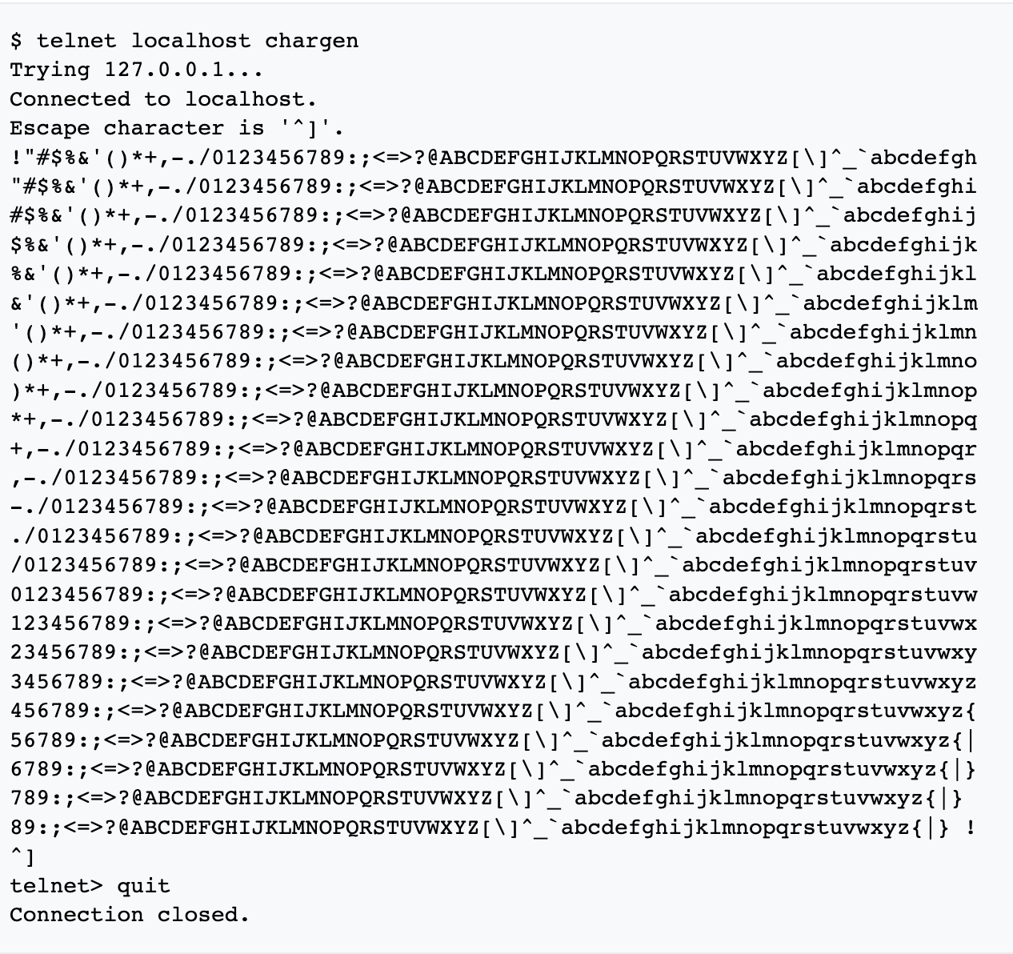
DDoS Attack 5 - Chargen
Super lame, but super fun if you can find one!
Some chargen implementations listen on UDP and TCP
Send a single character to a chargen port, and it will respond with a deluge of all ASCII printable characters on a loop
Hard to find an open chargen service on the innerwubs these days
Amplification Factor
Bytes:∞
Packets: ∞

Slide 11

DDoS Attack 6 - Echo
Another super lame one
Sends what you send back to you (or victim)
Hard to find one on the Internet
What happens when you craft a UDP chargen to connect to a UDP Echo service packet?
Amplification Factor
Bytes: 1x
Packets: 1x

Slide 12
DDoS Attack 7 - QoTD
More Lameness (this is the last one)
Sends a random quote back at you, up to 512 characters
Also hard to find on the Internet these days
Amplification Factor
Bytes: 512x
Packets: 1x

Slide 13
DDoS Attack 8 - NTP
Used to be super awesome, now it’s super lame
MONLIST would return a list of the 600 previous connectors
https://www.us-cert.gov/ncas/alerts/TA14-013A
Now you can just get the time. The ratio is 1:1 for number of bytes in to out. On purpose.
Amplification Factor
Bytes: 1x
Packets: 1x

Slide 14
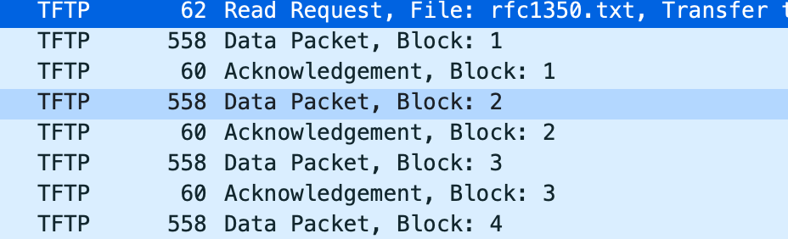
DDoS Attack 9 – TFTP
TFTP is a UDP based file transfer program
Used to provision firmware for networking gear, VoIP phones, switches, printers, etc.
Client issues a read request for a file, then 512 bytes are sent back. Client sends a “block acknowledge packet” and server sends next 512 bytes
The block acknowledgement packet is easy to predict (but why bother? Just keep requesting the file for first 512 byets)
Amplification Factor
Bytes: 8x
Packets: 1x

Slide 15
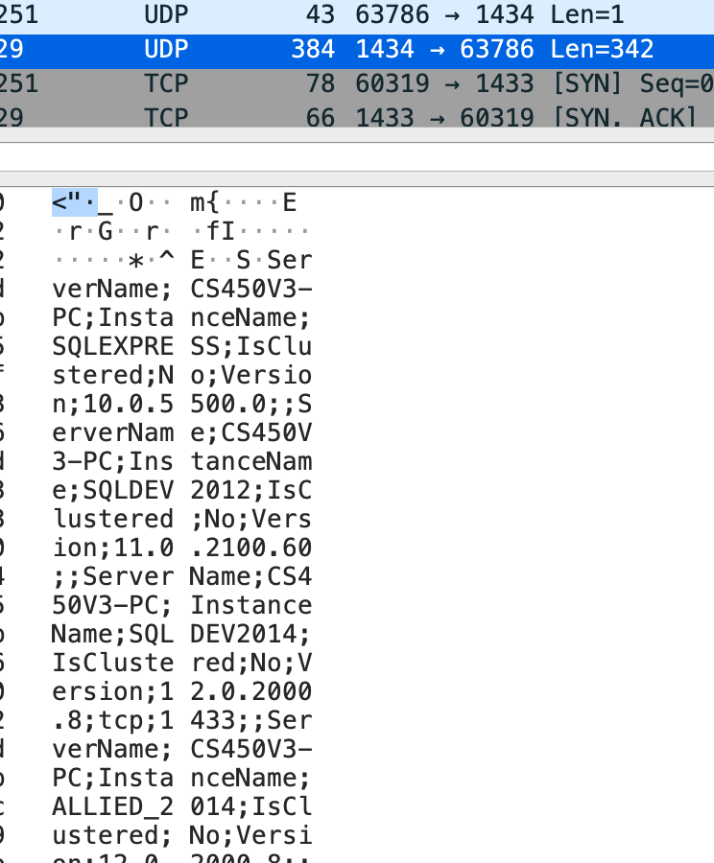

DDoS Attack 10 –MS-SQL
MS-SQL has a “ping” port
You send “\x03” to it, it comes back with details
Depending on those details, could be a lot of data
Can find these open servers with Shodan
Amplification Factor
Bytes: 4x-8x
Packets: 1x

Slide 16
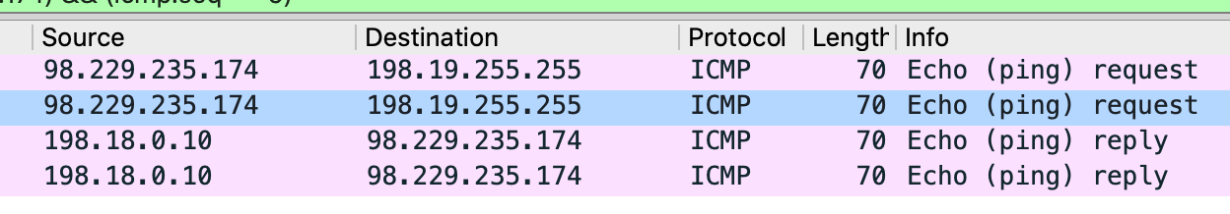
DDoS Attack 11 - ICMP
There’s a lot you can do here
Send a ping to a broadcast location, get # of devices response
Depends on location and equipment willing to respond
Amplification Factor
Bytes: size_of(subnet_of_things)
Packets: size_of(subnet_of_things)

Slide 17
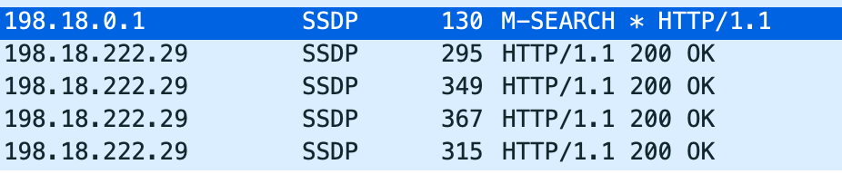
DDoS Attack 12 – SSDP –aka – UPnP)
SSDP is also known as UPnP
Designed to find your devices on your local network
Meant to use a local multicast address 239.255.255.250 only
But no one “listens”
https://blog.cloudflare.com/ssdp-100gbps/
Amplification Factor (Cloudflare’s numbers)
Bytes: 26x
Packets: 8x

Slide 18
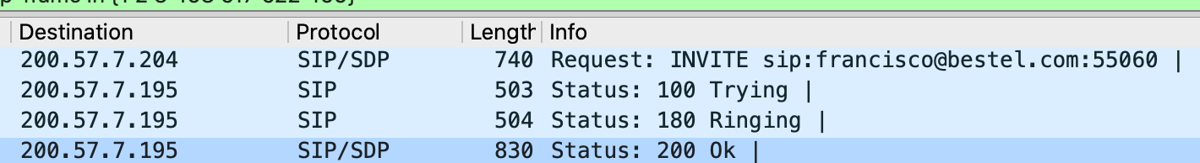
DDoS Attack 13 - SIP
Send a SIP INVITE Packet
Response is two Packets
100 Trying
180 Ringing
Amplification Factor (depends on INVITE request size)
Bytes: 2.5x
Packets: 3x

Slide 19
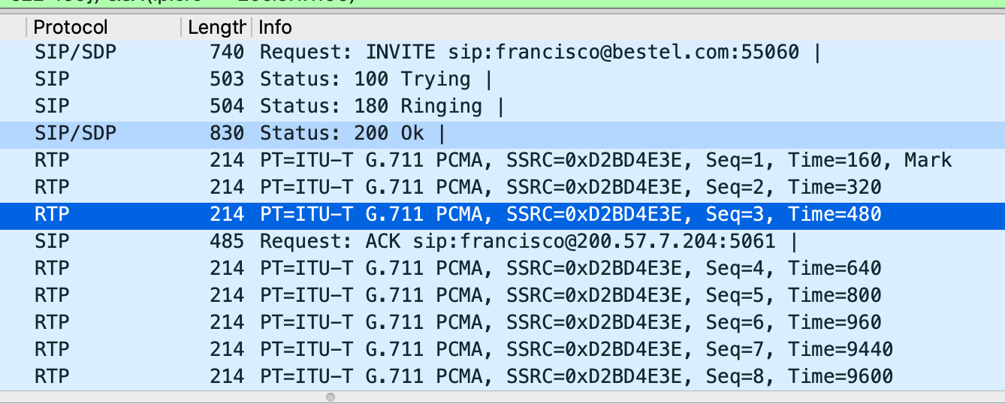
DDoS Attack 14 – RTP Flood Caused by SIP
SIP has no default authentication
Can find a call center, voice gateway, automated system
No need for any more packets than a SIP INVITE
Many times SDP message will point to a different IP to receive the data voice/RTP packets.
This means you can make an RTP session streaming data calls to unsuspecting victim with one SIP INVITE message
Amplification Factor
Bytes: 5x - ∞
Packets: 5x - ∞

Slide 20
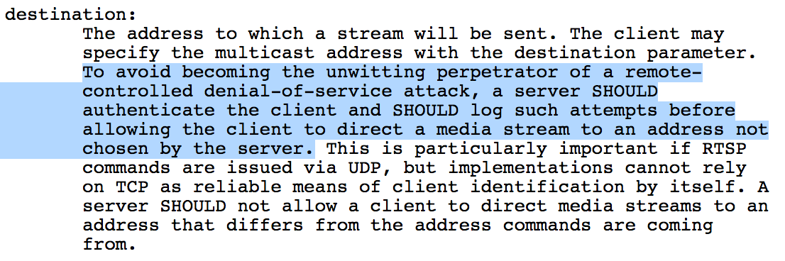
DDoS Attack 15 RTSP redirected RTP
Same thing as SIP
RTSP is our first connection oriented (TCP based) protocol!
In the SDP message, you can point to another host
Some really poorly designed RTSP streaming servers will direct the RTP anywhere you ask them
Amplification Factor
Bytes: ∞
Packets: ∞
https://www.ixiacom.com/company/blog/how-i-made-my-camera-ddos-cannon

Slide 21
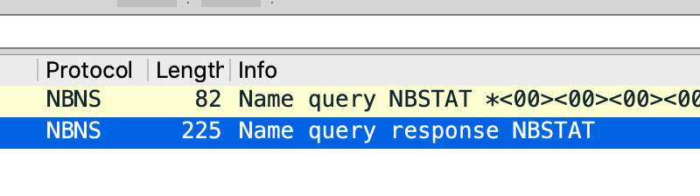
DDoS Attack 16 – NetBIOS still a thing!
You can treat NetBIOS a lot like DNS
Basic query will normally return a record size 2x
I believe there is more hiding in this space
Amplification Factor
Bytes: 2.7x (maybe more)
Packets: 1x

Slide 22
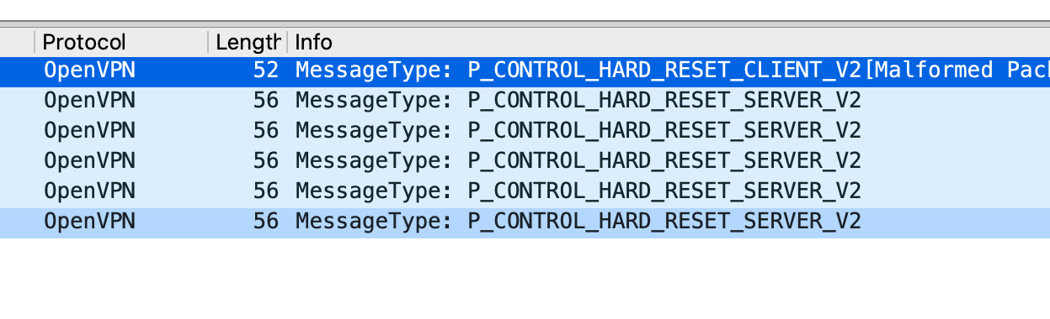
DDoS Attack 17 – OpenVPN UDP
OpenVPN wants to communicate
Responds to malformed handshake requests with repeated responses
Amplification Factor
Bytes: 5.38x
Packets: 5x

Slide 23
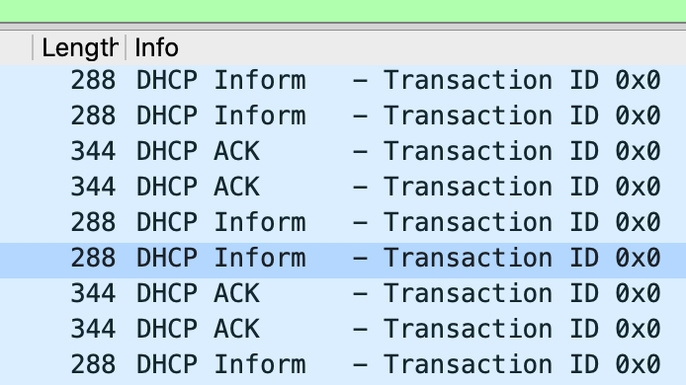
DDoS Attack 18 – DHCP?
DHCP is _meant_ to be broadcast only
it will still respond to unicast queries
Send a DHCP Inform
This one can probably be improved by using extended options queries..
Amplification Factor
Bytes: 1.20x
Packets: 1x

Slide 24
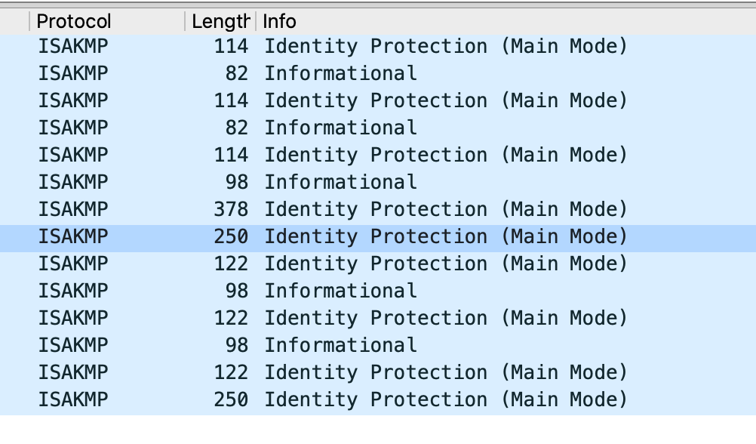
DDoS Attack 19 – AutoKey IKEv1
VPN’s are fun!
This one requires fine tuning
Can end up upside down on ratios
Depending on VPN configuration could be higher
No one will ever find this in their logs
Because no one understands how a VPN works
Amplification Factor
Bytes: 2.2x
Packets: 1x
ike-scan --trans="(1=5,2=2,3=1,4=2,11=1,12=7080)"
Notes:
This one was a real PITA. Had to keep looking into correct ciphers to propose in request. Once you find the magical combination though, you have quite a hidden bomb available.

Slide 25
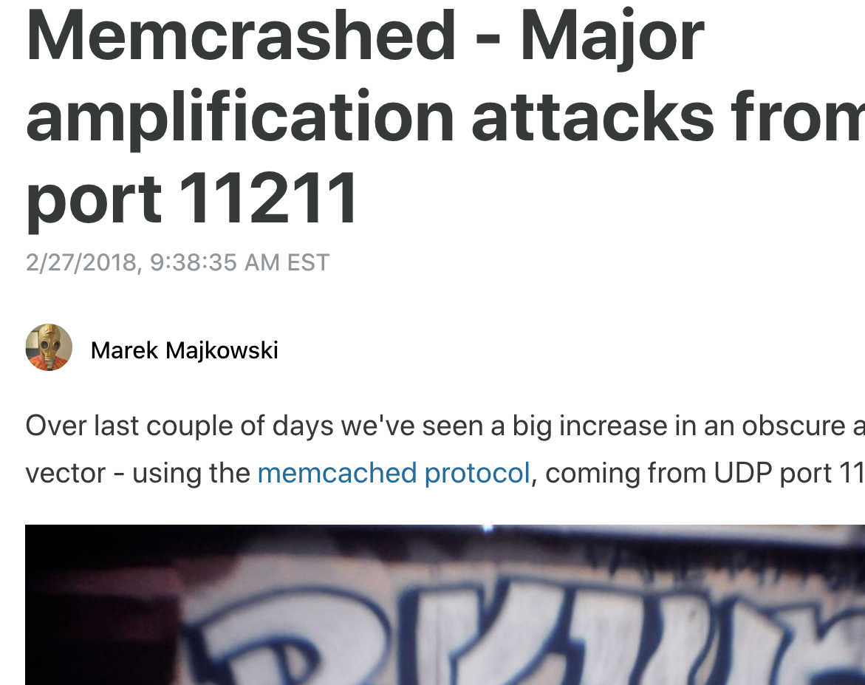
DDoS Attack 20 - Memcached
Caching service designed by Facebook I think
UDP, authenticationless, small packets, huge responses
Cloudflare witnessed huge attacks in 2018 from this
Amplification Factor
Bytes: 51,200x
Packets: 500x
https://blog.cloudflare.com/memcrashed-major-amplification-attacks-from-port-11211/

Slide 26
DDoS Attack 21 – HTTP/3?
Currently having spent about an hour looking at it, looks like negative amplification factor
Still it is connectionless
And _will_ be the dominate protocol on the Internet
Will be really hard to prevent reflection/hiding at least
¯\_(ツ)_/¯

Slide 27
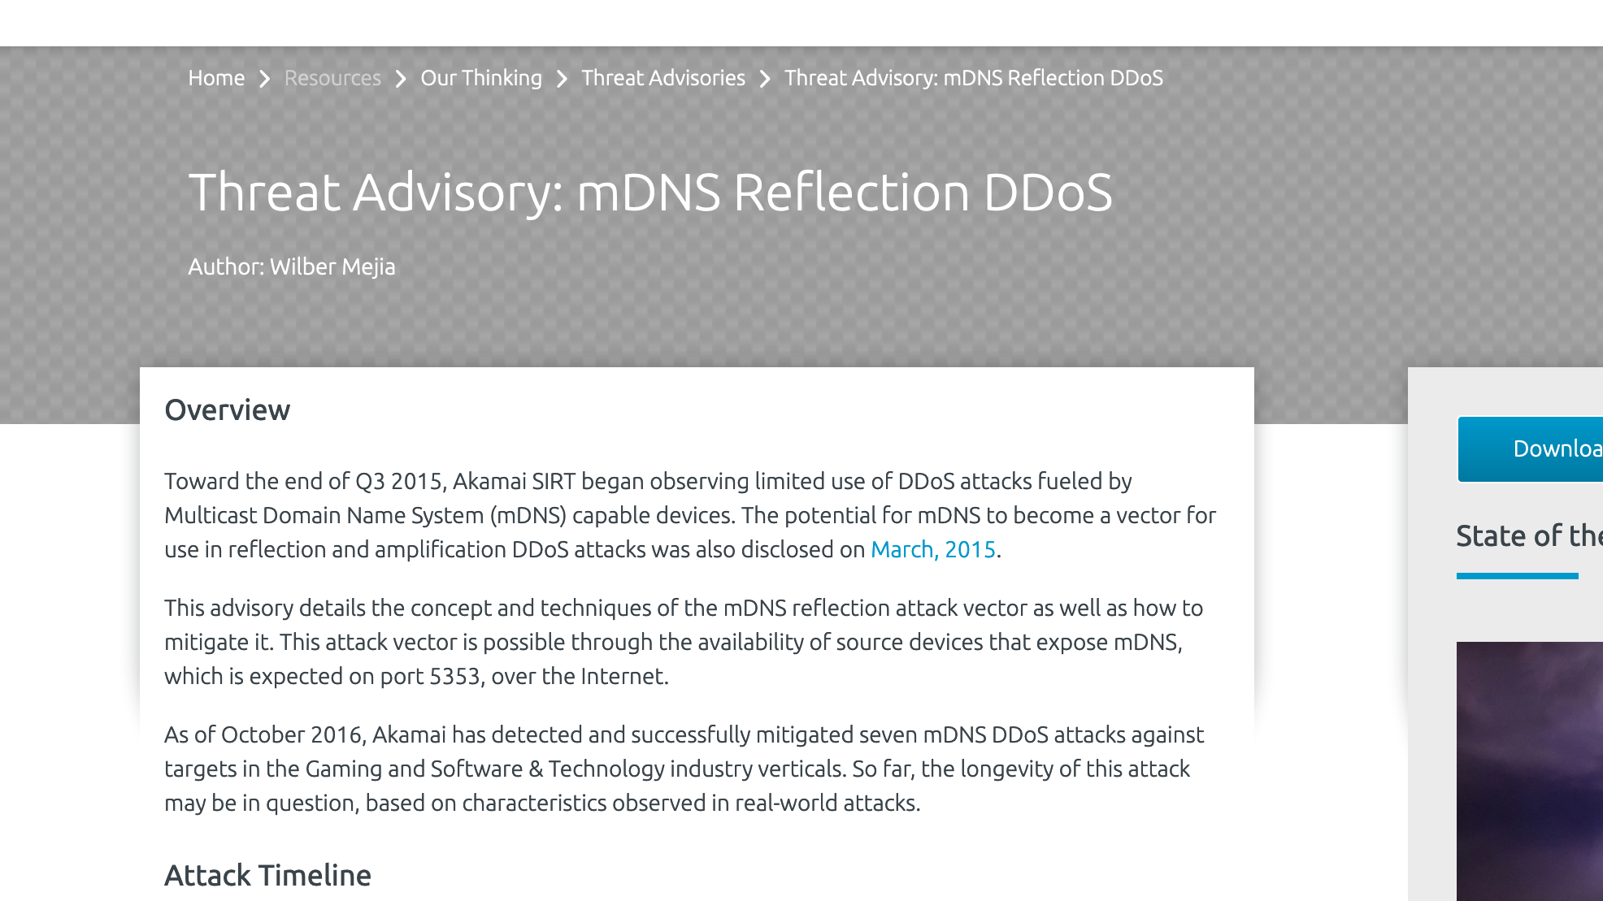
DDoS Attack 22 - MDNS
Same issues as UPnP
Can force a multicast protocol to use unicast responses
Not all IoT is going to pay attention to the fine print
Amplification Factors
Similar to UPnP
https://www.akamai.com/us/en/resources/our-thinking/threat-advisories/akamai-mdns-reflection-ddos-threat-advisory.jsp

Slide 28
Conclusions
All but one of these attacks is a direct form of reflection
There will always be another protocol for abuse
Avoid connectionless exchanges
Make sure your protocol’s response is smaller than initial request
Any interest in a github of PoC’s?
@nobletrout

